Slide 1
Security Monitoring Best Practices (Detection, Analysis, Incident Response) NRF IT Security Council
Joe Partlow, ReliaQuest
June 2015

Slide 2
Who am I?
Joe Partlow (jpartlow@reliaquest.com) – CISO, ReliaQuest
CISSP, CISM, GSEC, CEH, NSA-IAM, ArcSight Certified Partner
Joe has been in the IT and information Security industry for 15+ years and has experience in Operations Management, Information Security, Network Security, Systems Design, Risk Assessment, Database Administration, Network Infrastructure, Web Application Development, Systems Design & Integration and Project Management.
Currently oversees 55 technical professionals and all technical operations at ReliaQuest including Security Operations Center, Field Engineering, and RQLabs.

Slide 3
Key 2015 Verizon Statistics
Every year Verizon puts out it’s Data Breach Investigations Report (DBIR) highlighting risks and vulnerabilities over the past year. Key takeaways for security monitoring:
“In 70% of the attacks where we know the motive for the attack, there’s a secondary victim”
“About half of the CVEs exploited in 2014 went from publish to exploit in less than a month”
“23% of recipients now open phishing messages and 11% click on attachments”

Slide 4
Key 2015 Verizon Statistics – Cont.
“99.9% of the exploited vulnerabilities had been compromised more than a year after the associated CVE was published.”
“40% of controls determined to be most effective fall into the quick win category.”
Patching Web Services
User Lockout after multiple failed attempts
Mail attachment filtering
Limiting ports and services
Restrict ability to download software (admin rights in general)
Up to date antivirus/antimalware

Slide 5
Top 3 Risks and Vulnerabilities
Risks, vulnerabilities and missing mitigation controls most seen by our risk and vulnerability assessment teams:
No complete inventory of systems on the network or applications used in environment. You can’t secure what you don’t know about!
No central logging or monitoring for systems and applications on the network. You won’t know if you have been compromised without complete visibility!
No consistent vulnerability and patch management program. Find your vulnerabilities before the bad guy does..

Slide 6
Security Monitoring Essentials
Having a Secure Operating Center (SOC) or assigning individuals to actually see what is happening in your environment is critical. Every environment is different, however there are come key components needed to do effective security monitoring whether a small business or Fortune 50.
This is much more than throwing some bodies in a room with monitors on the wall. Typically can be grouped into People, Process and Technology.
Essential items we have run into from our own SOC and from managing others...

Slide 7
Secure Operations Center - People
Multiple roles needed in the SOC, but scale up as the SOC matures:
Incident Responders – People actually watching for alerts in the environment from your SIEM or other technology and escalating to engineers or system owners.
Content Engineers – Engineers tasked with writing all the content (dashboards, reports, alerts, etc.) for all devices and applications in the environment. Usually a moving target!
SIEM Engineers – Engineers responsible for keeping the actual SIEM upgraded, working efficiently, collecting events and parsing log sources.

Slide 8
Secure Operations Center – People Cont.
Advanced teams for more proactive monitoring/response:
Hunt Team – IR personnel that are proactively sifting through the events and logs to find new patterns or trends that the existing alerts may not be picking up on.
Red Team – Test if your alerting and escalation process is working. Use your existing vulnerability assessment team, they love breaking stuff!
Forensics Team – Usually outsourced, but if you can do it in house or at least have a team trained to correctly hand off to the third party, you can save a lot of time/headaches.

Slide 9
Secure Operations Center – People Cont.
Don’t forget about ongoing training, some certifications or courses to start with:
SANS Incident Analyzer (GCIA)
SANS Incident Handler (GCIH)
Basic scripting (Powershell, Python, Bash)
Basic network analyzing (TCPDump/Wireshark)
Forensic Certs (CCE, SANS GCFA)
Operating system basics (Windows and Linux)
Soft Skill training – Critical to communicate up the chain (Report writing, presentation classes, etc.)

Slide 10
Secure Operations Center - Process
Certifications such as ISO27001 or SOC 2 can help guide your overall processes and procedures.
Create Operation Guides (run books) for all technologies being monitored so you aren’t wasting time figuring out the tools when something happens.
Incident Response checklists
What happens when an alert comes in?

Slide 11
Incident Response
Having good process and procedures is critical to effectively handling an issue. Some high-level items to make sure the analysts are performing:
Determine urgency – What is the severity of the event?
Collect basic information available – User info, source, destination, protocol, etc.
Analyze Information collected – Correlate across other technologies (Ex. Brute force attack or misconfigured service account?)
Time based analysis – How often and when is it occurring?
Environmental situation awareness – Is this occurring in a protected area of the network (DMZ, PCI Zone, etc.)
Historical information gathering – Has this happened before and where?

Slide 12
Secure Operations Center - Technology
Central Logging and Alerting - Tools that will gather all the logs from your various sources and provide some basic alerts to your team. SIEM tools add a correlation engine to provide true IR, but also an added layer of complexity. Don’t forget about aggregation and filtering…
What to monitor?
Authentication (Active Directory, TACACS, Radius)
IDS/IPS (Sourcefire, Tipping Point, McAfee)
File Integrity Monitoring (Tripwire)
EndPoint Mgmt (ECAT, AV, OSSEC)
WAF (Trustwave, Imperva, F5)
Infrastructure (Firewalls, Routers, Load Balancers)

Slide 13
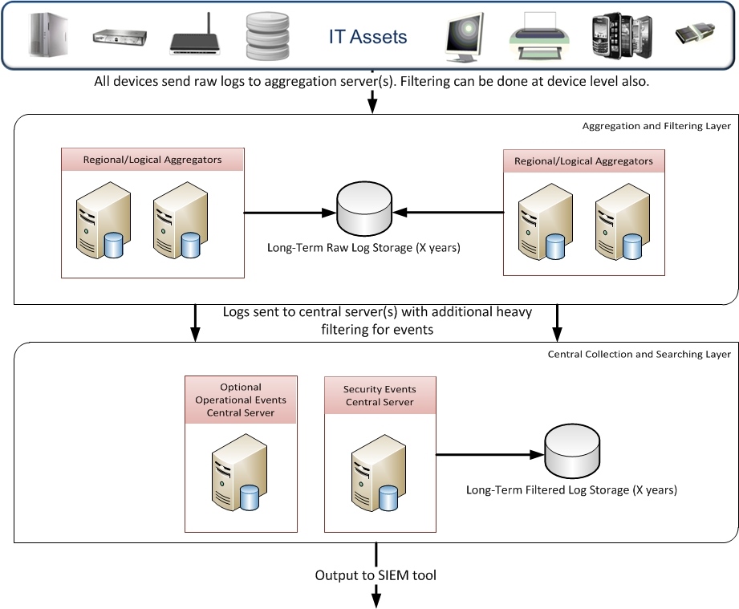
Secure Operations Center - Technology

Slide 14
Secure Operations Center - Technology
Meaningful Use Cases – Create content that can track or show intent of users or activity across the entire enterprise.
Critical for ongoing operations, otherwise just doing log storage.
Operational, Threat Intel, Executive levels.

Slide 15
Use Case Methodology
Executive Use Cases
Compliance
PCI
DISA STIG
SANS Top 20
Trending
0days
Top Attacks
New Attacks
HIPAA
Threat Analysis Use Cases
External Threat
Inbound high risk ports
Social Engineering
Phishing Attempts
Physical Security
Access Cards
NAC
Unauthorized Access
Privilege escalation
Service Account logins
Insider Threat
USB use
Data exfiltration
Black List source/destinations
Black List
Malware/AV
Motion camera triggers
Rogue AP
Privilege escalation
Operational Use Cases
Firewalls
Firewall Access
IDS/IPS
Top sources
Web Servers
500 Error Checks
Active Directory
Admin group membership
DNS
Zone Transfers
SSH Logins
Routers/Switches
Write commands
DDoS conditions
User Agent Checks
VMWare
Snapshots
Name Resolution
Traffic Source
New Servers
Reconfiguration
Top destinations
Most triggered
Excessive logins
SSH logins

Slide 16
Example Kill Chain 1
Application
WAF/Web Logs – Detect website injection attack
Active Directory Logs– Detect administrative login to protected area of application/network
Data Loss
SQL/Application Logs – Detect privileged user login to database
SQL Audit/DAM Logs – Detect large dump of user tables
Data Exfiltration
Web Proxy/Firewall Logs – Detect outbound traffic with large payload and/or “dropbox” type site.
Social Network/OSINT – Detect mention of data dump or other company related disclosures

Slide 17
Example Kill Chain 2
Remote Access
VPN/Remote Access Logs – Detect contractors logging in at off hours
Server/Workstation Logs– Detect administrative login to protected area of application/network by unauthorized users or outside of scope
Malware
Malware Detection Logs – Detect malware installation or activity on terminals.
Egress/Proxy Logs – Detect outbound traffic to non-trusted destinations.
Data Exfiltration
Netflow Logs – Detect outbound traffic with non-standard/abnormal protocols (FTP, Large/Excessive DNS requests, SSH, etc.)
Social Network/OSINT – Detect mention of data dump or other company related disclosures

Slide 18
Secure Operations Center – Technology
Threat Intelligence – Known what is happening before it hits you. Also think outside the box, many good free or open source ways to get intelligence.
Honeypots – global trending (good) or customer specific to give higher level of accuracy (better)
Social Network monitoring – Twitter, pastebin, google, Shodan, etc.
External Threat Analysis – Google, Maltego, Facebook, etc.
OSINT Feeds – SANS Dshield, MalwareDomains, Emerging Threats, etc.
Commercial Feeds – ThreatStream, iSight, Xforce, AV ATX, etc.

Slide 19
Secure Operations Center - Challenges
What level of support will they provide?
Tier 1 – Basic Incident Response to existing alerts
Tier 2 – Root cause analysis
Tier 3 – Forensic support
How to gauge intent? Is the account lockout due to forgetfulness or brute force attempts? Correlation to other sources can help determine…
Vendor Support - How much internal engineering vs. vendor or third party support?

Slide 20
Secure Operations Center – Challenges Cont.
Visibility - Unfortunately the security team is the last to know when devices or applications are added to the enterprise. Need to see everything from the perimeter to the endpoint.
Staffing – Where to find the talent?
Recruit from local security groups and conferences, CTF competitions, internships, etc.
Level of Monitoring – Operational Events vs. Security Events
Other – Fun stuff you never think of...

Slide 21
What next?
There are many layers of security, we typically spend 6-8 weeks doing assessments before anything actually gets fixed. Some rules we follow are:
Don’t get discouraged. New attacks are coming out daily, so it might look as if no end is in sight.
Start with visibility into the environment.
Mix in open source tools if you don’t have unlimited budget – many are perfectly fine.
Many good online or local resources to get educated. Google is your best resource!
Work with each other – the enemy of my enemy…

Slide 22
Thank You Questions?
For more information:
Joe Partlow
Web: reliaquest.com | Twitter: @reliaquest
jpartlow@reliaquest.com

